Slide 1
Agency Prepayment: Default
June 2015

Slide 2
Outline
Introduction to Default
Description of Data
Empirical Observations and Comparisons
Description of Framework
Results
Spline Results
Delinquent Loans Spline Results
Going Forward
CLTV consistency

Slide 3
Introduction to Default
Agency Delinquency Definition
Loans that miss monthly payments are marked as 30 Days, 60 Days, 90 Days, 120 Days delinquent
Agency Default Definition
Loans that miss a certain number of payments (~120) are repurchased from the pool
Default Statistics
Current Loans: 1.37 CDR
Delinquent Loans: 6.75 CDR

Slide 4
Description of Default Data
Prepay Data
Pool Level
Delinquency/Default information only available for Freddie pools
~ 352 K pools with data as far back as 2011
30 Day, 60 Day, 90 Day, 120 Day and Repurchased balances are available
Loan Level
No Delinquency/Default information is available
Credit Data
Delinquency/Default information available for Fannie and Freddie loans
~ 40 M loans with data as far back as 1999
Loan Age up to 180
Has indicators for Prepayment, and Default
Excellent coverage for FICO, DTI, CLTV (msa level), Occupancy, etc.

Slide 5
Description of Default Data: Default Definition
Prepay Data
Pool Level: Default Definition
120 day delinquent loans are removed from the pool
Default balance is reported
Credit Data
Loan Level: Default Definition
180 day delinquent loans are removed from the data and a Zero Balance Code is reported
Revised Credit Data
We must modify the default criteria to match with the Pool data
First time a loan reaches 120 days delinquent, the loan is marked as a default
Default Empirical Formula
MDR (monthly default rate) = default balance / current balance

Slide 6
Empirical Observations and Comparisons
Different time periods make direct comparison of the CDRs difficult
- Pool ~2011-2015
- Loan ~2000-2015

Slide 7
Empirical Observations and Comparisons
Same time period demonstrates comparable CDRs
- Pool ~2011-2014
- Loan ~2011-2014

Slide 8
Empirical Observations and Comparisons
Pools demonstrate significant CDR variability

Slide 9
Description of Framework
Data
Query the loan level credit data from IQ
Aggregate the Default data by loan characteristics
CLTV: 30, 40, 50, 60, 70, 80, 90, 100, 110, 120, 140, >140
FICO: 500, 540, 580, 600, 620, 640, 660, 680, 700, 720, 740, 760, 780, 800, >800
WALA: 10, 20, 30, 40, 50, 60, 70, 80, 90, 100, 120, 140, >140
DTI: 20, 30, 40, 50, >50
Occupancy: OWNER, NON_OWNER
R Program
Read in the aggregated data
Determine by statistical methods which variable is most important
Calculate the balance weighted factor variables and MDR (monthly default rate)
Estimate a spline from the empirical data
Repeat process for next most important variable
Output
Spline coefficients, which allow us to calculate an MDR given a set of loan characteristics

Slide 10
Description of Framework
1.Bucket and Weighted Mean
2. Spline and Interpolation
3. Least Square Optimization

Slide 11
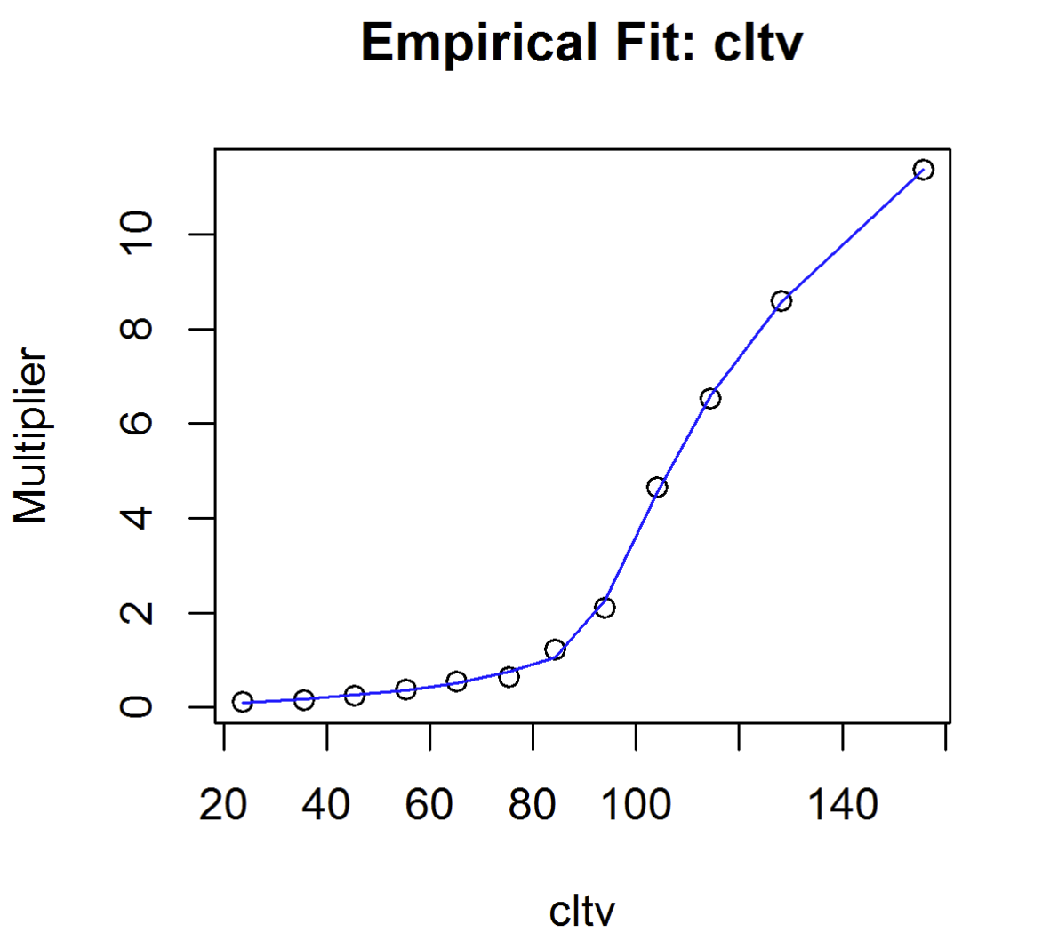
Results: CLTV

Slide 12
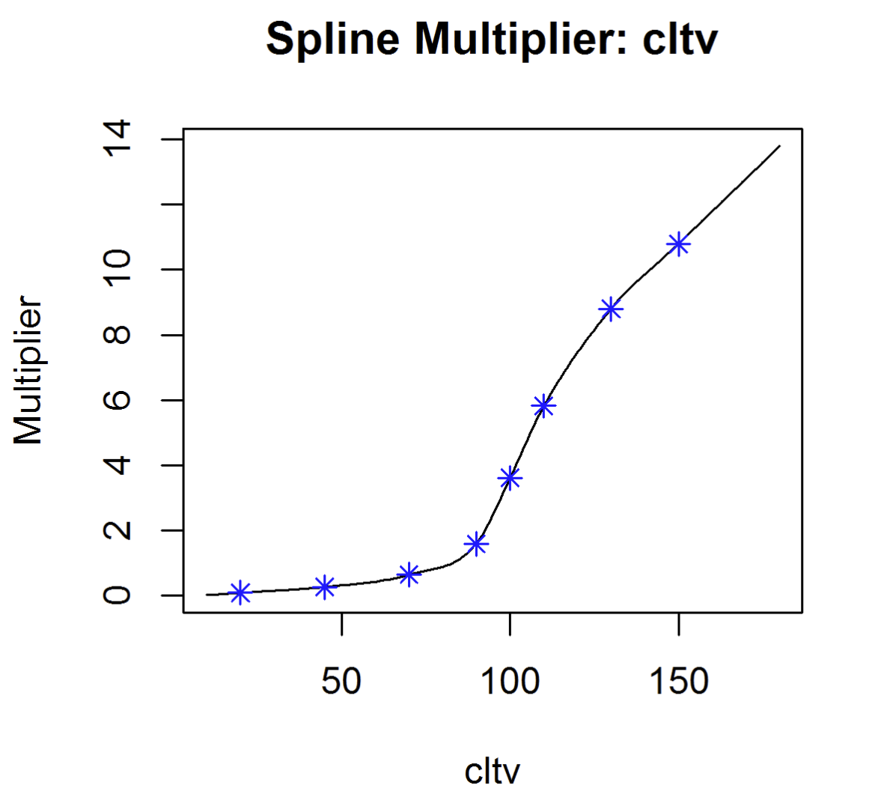
Results: CLTV

Slide 13
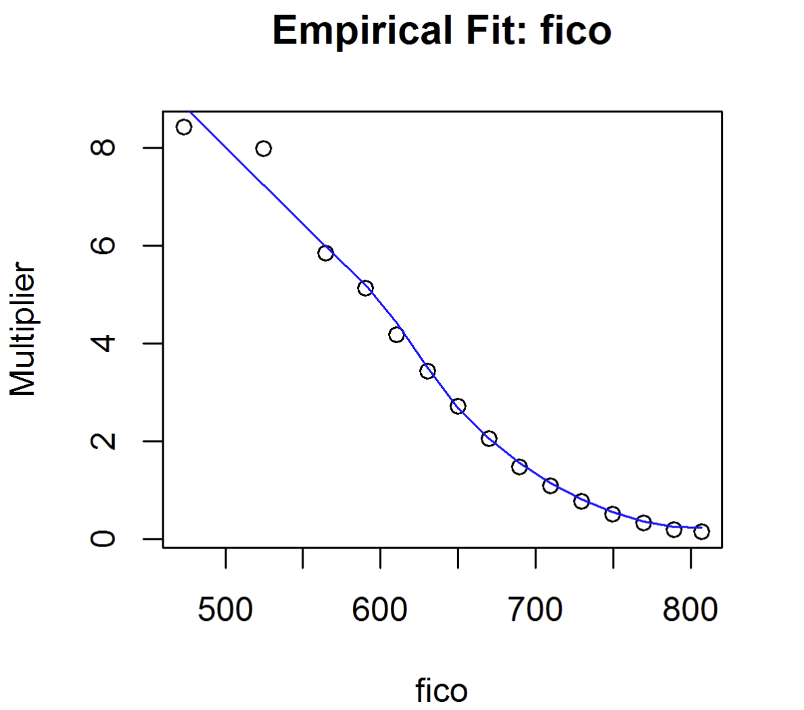
Results: Original FICO

Slide 14
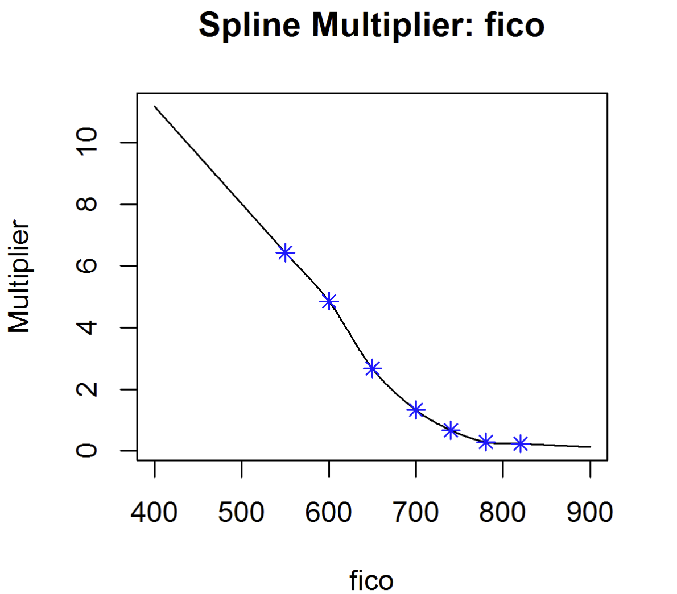
Results: Original FICO

Slide 15
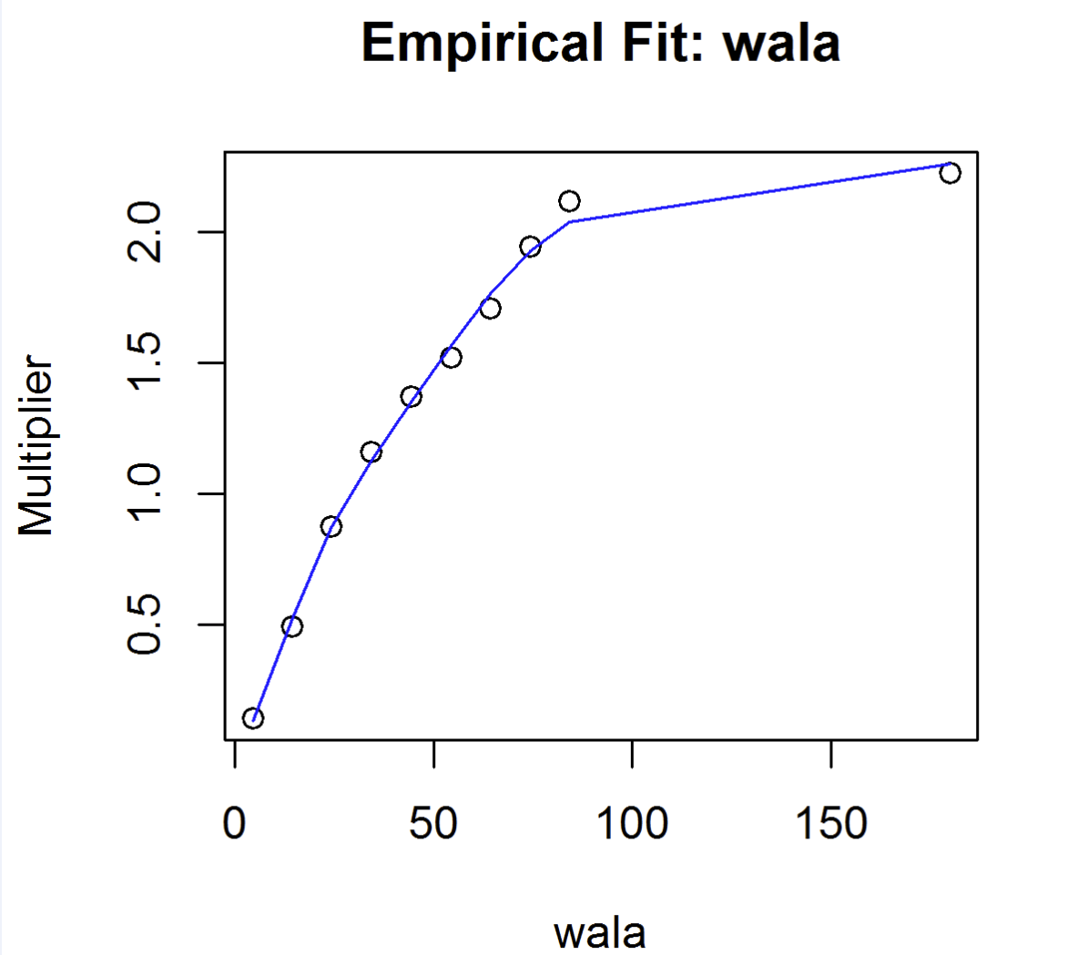
Results: WALA

Slide 16
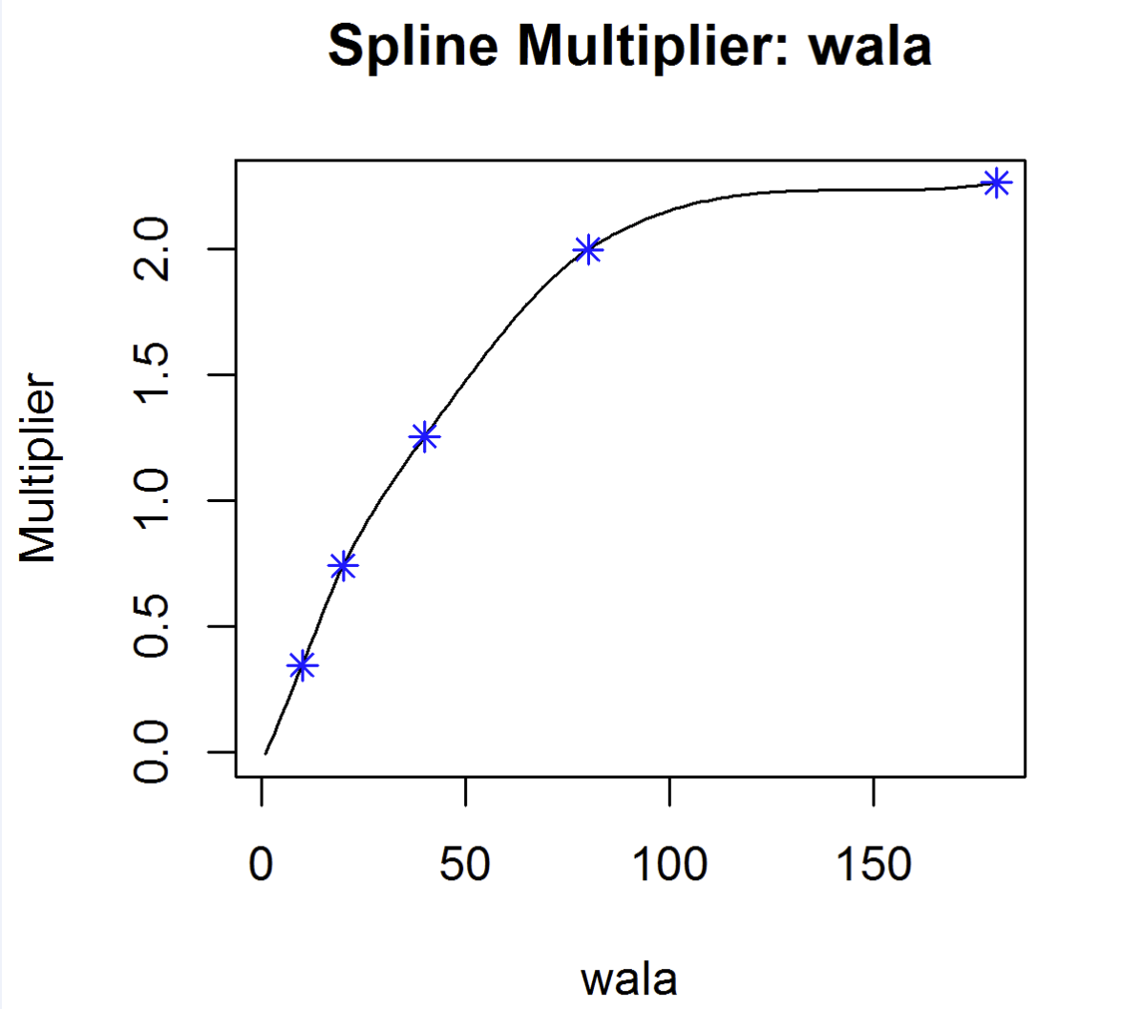
Results: WALA

Slide 17
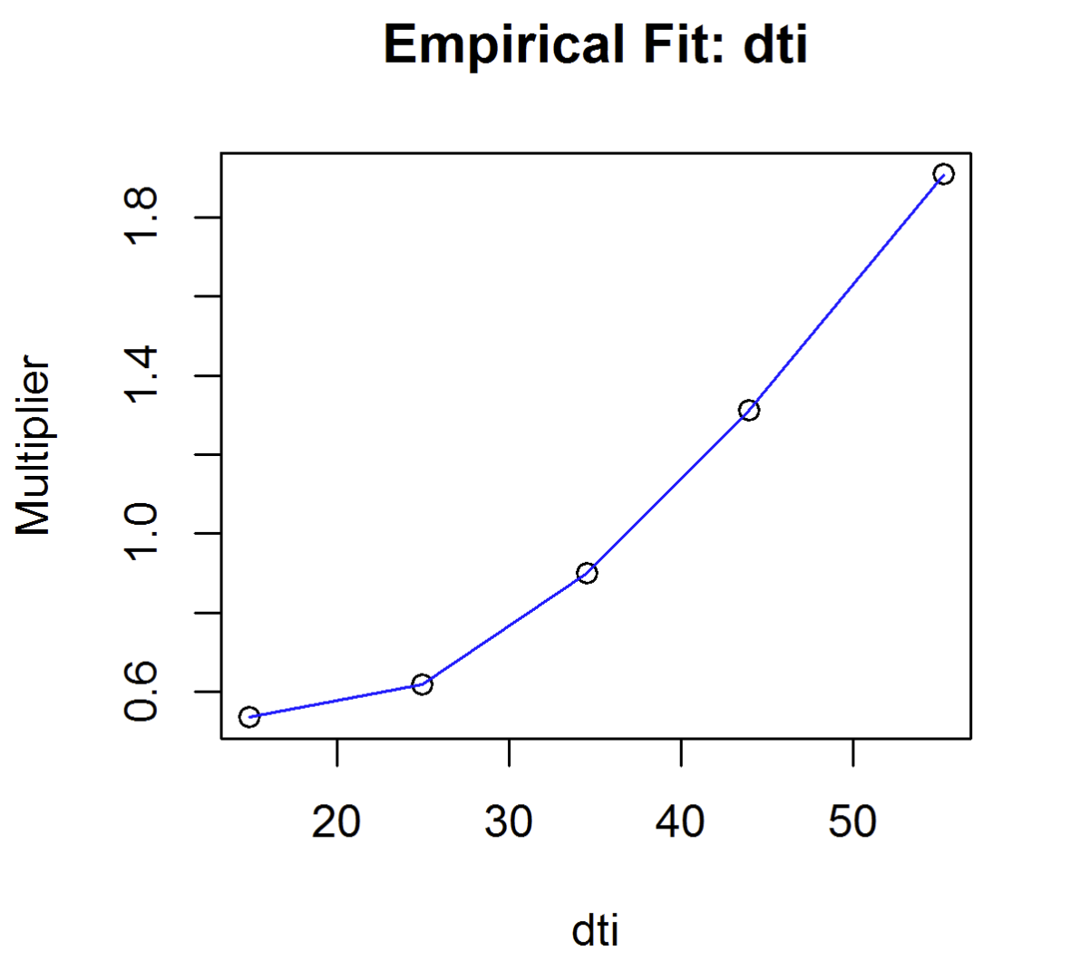
Results: Original DTI

Slide 18
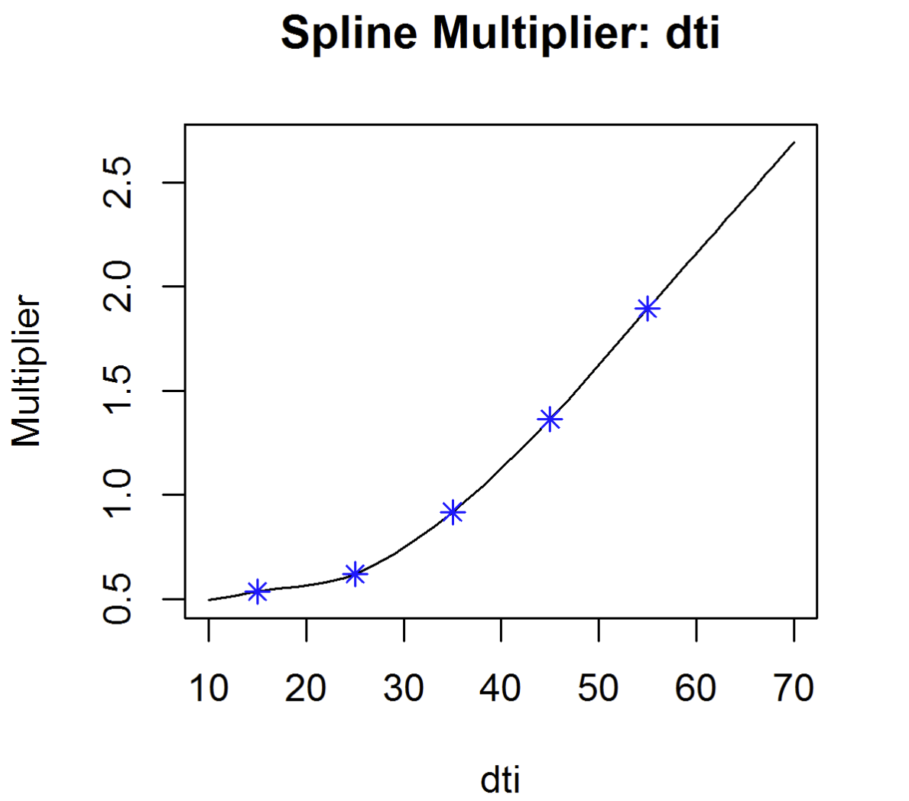
Results: Original DTI

Slide 19
Results: Delinquency
Agency Pools reported by Freddie Mac have delinquency information:
Ex) 94% Current, 3% 30Days, 2% 60Days, 1% 90Days
Delinquency Status has a significant impact on the default rate
Hence we must specify a model for the part of the pool which is delinquent
We follow essentially the same strategy as before
The results are as expected:
A significantly higher average default rate (~5 x)
Similar spline shapes but with smaller impact on the default rate

Slide 20
Results: Delinquency

Slide 21
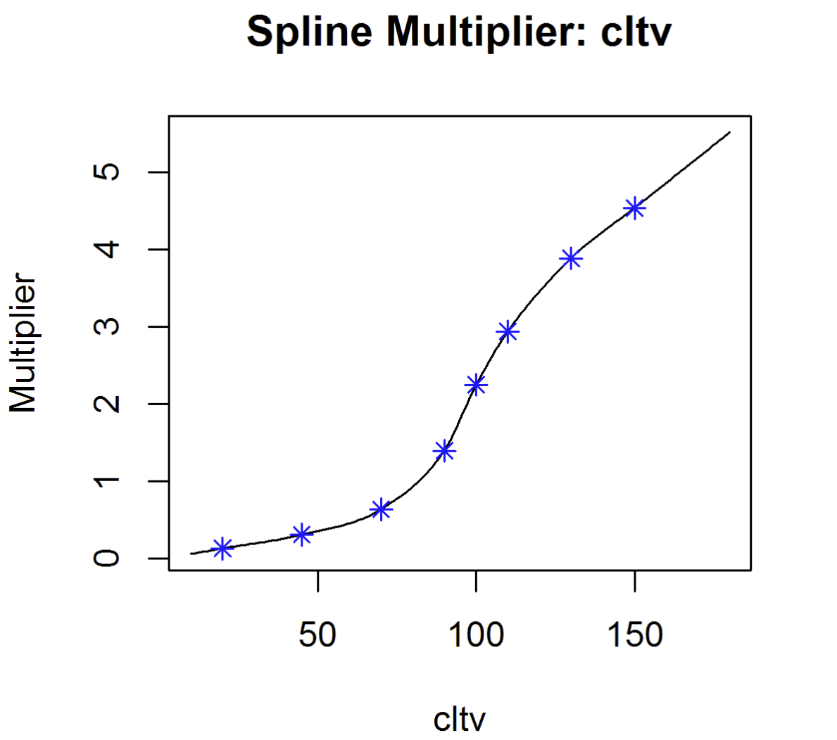
Results: Delinquency Multipliers

Slide 22
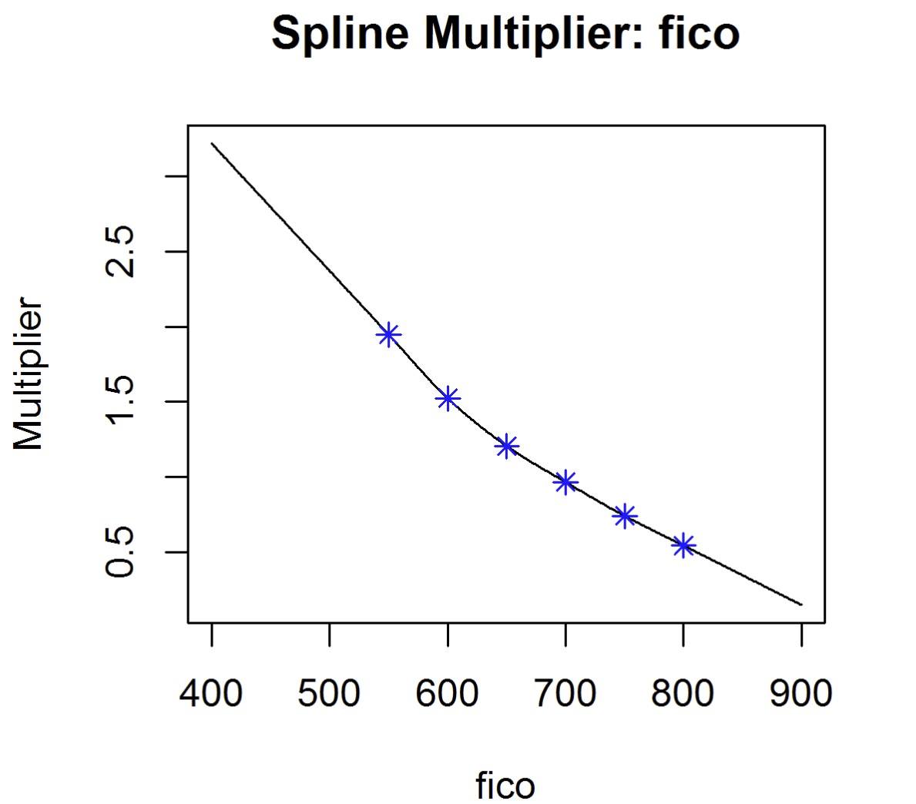
Results: Delinquency Multipliers

Slide 23
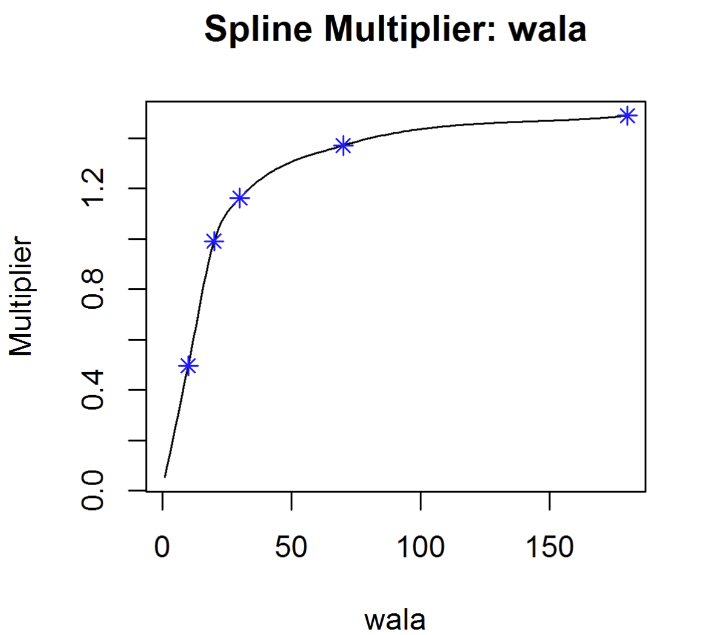
Results: Delinquency Multipliers

Slide 24
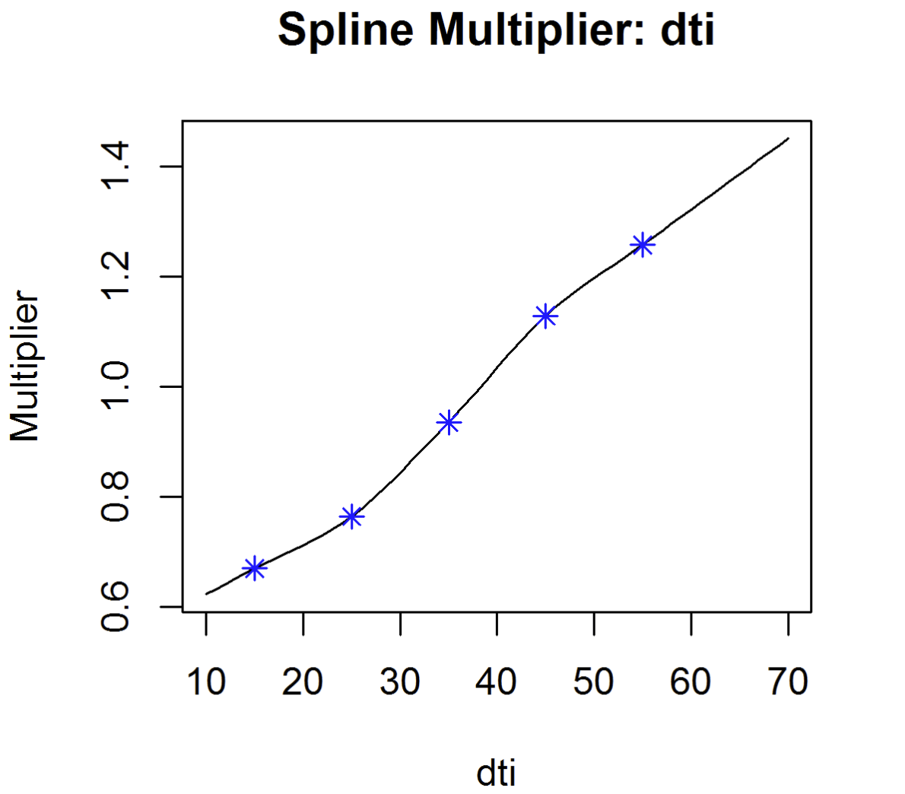
Results: Delinquency Multipliers

Slide 25
Results: Occupancy
Occupancy Multipliers
Current Loans
NON_OWNER = 1.368
OWNER = 0.963
Delinquent Loans
NON_OWNER = 1.096
OWNER = 0.991

Slide 26
Going Forward: CLTV Consistency
There is an issue with the CLTV calculation from the credit data vs the prepay data
Prepay Pools calculate Current CLTV from “Purchase Only” HPI time series
Credit Data calculates Current CLTV from “All Transactions” HPI time series
Results are not consistent
TODO:
Create another CLTV in the credit tables with data from the Purchase Only HPI time series
Redo the analysis to use the compatible CLTV

